Slide 1
Teacher Effectiveness Initiative Value-Added Training
Value-Added Research Center (VARC)
Notes:
This presentation expands the “Oak Tree Analogy” to address common questions people tend to have about Value-Added modeling.
topics covered are:
What about tall or short trees?
(high or low achieving students)
How does VARC choose what to control for?
(proxy measurements for causal factors)
What if a gardener just gets lucky or unlucky?
(groups of students and confidence intervals)

Slide 2
Oak Tree Analogy Expansion
What about tall or short trees?
(high or low achieving students)
How does VARC choose what to control for?
(proxy measurements for causal factors)
What if a gardener just gets lucky or unlucky?
(groups of students and confidence intervals)

Slide 3
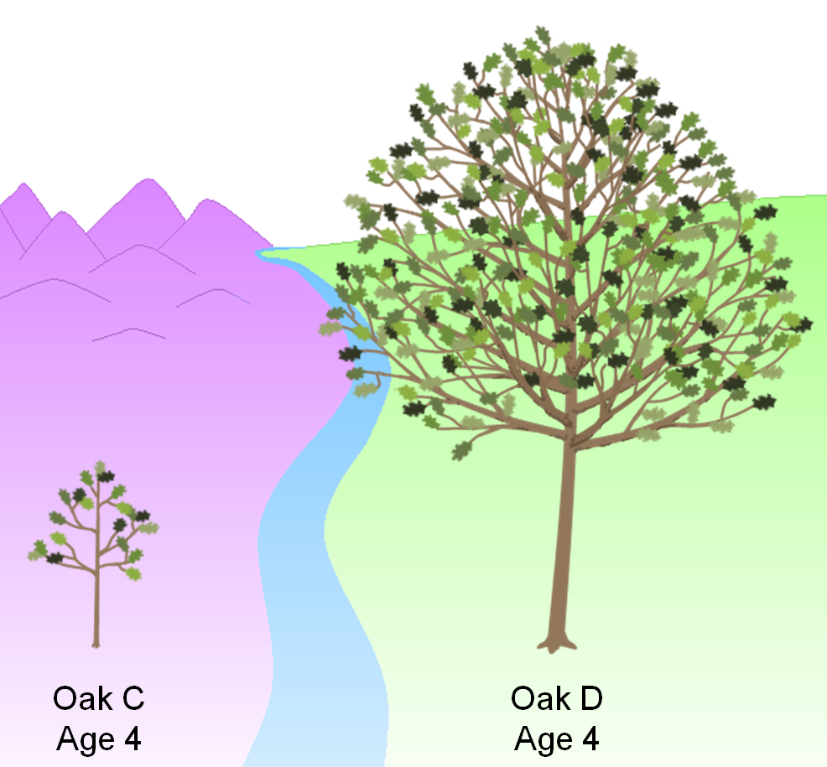
1. What about tall or short trees?
(High or low achieving students)

Slide 4
1. What about tall or short trees?
If we were using an Achievement Model, which gardener would you rather be?
How can we be fair to these gardeners in our Value-Added Model?
93 in.
Gardener C
Gardener D
28 in.
Oak C
Age 4
Oak D
Age 4
Notes:
In our analogy versus education context table, we mentioned prior tree height but did not go into details about this characteristic.
These two gardeners are about to care for these two trees for the next year.
If we were using an achievement model, which gardener would you rather be?
How can we be fair to these gardeners in our Value-Added model?

Slide 5
Why might short trees grow faster?
Why might tall trees grow faster?
More “room to grow”
Easier to have a “big impact”
Past pattern of growth will continue
Unmeasured environmental factors
How can we determine what is really happening?
Gardener C
Gardener D
Oak C
Age 4
Oak D
Age 4
Notes:
First of all, let’s think about whether tree height might have an effect on tree growth.
In general, why might short trees grow faster in the following year of gardener’s care?
Why might tall trees grow faster?
You can probably come up with some of your own guesses.
Some guesses we came up with for short trees are: shorter trees having more “room to grow” and that it might be easier for a gardener to have a “big impact” on the growth of that tree.
For tall trees, we guessed that tall trees have likely experienced a pattern of rapid growth in previous years, so this pattern might continue. In general, tall trees might be benefiting from some other environmental factor that we haven’t controlled for explicitly. This factor may benefit tall trees again next year.
These are all guesses about why gardeners with short trees or tall trees might be at an advantage. How can we determine what is really happening?

Slide 6
In the same way we measured the effect of rainfall, soil richness, and temperature, we can determine the effect of prior tree height on growth.
The Effect of Prior Tree Height on Growth
30 in
Growth from Year 4 to 5 (inches)
9 in
Oak C
(28 in)
Oak D
(93 in)
Prior Tree Height (Year 4 Height in Inches)
Notes:
In the same way we measured the effect of rainfall, soil richness, and temperature, we can determine the effect of prior tree height on growth.
We collect data on all Oak Trees in this specific region and measure whether short or tall trees grew faster.
In this case, we determine that tall trees tended to grow more.
In the earlier analogy, we assumed that all trees grew 20 inches during a year of care and then refined our predictions with each tree’s environmental conditions.
By including prior height in the model, we can improve our predictions by taking this data into account.
For example, before considering environmental conditions, Oak C with a starting height of 28 inches would be predicted to grow 9 inches. Oak D with a starting height of 93 inches would be predicted to grow 30 inches.

Slide 7
Our initial predictions now account for this trend in growth based on prior height.
The final predictions would also account for rainfall, soil richness, and temperature.
+30 in.
How can we accomplish this fairness factor in the education context?
+9 in.
Oak C
Age 4
Oak C
Age 5
(Prediction)
Oak D
Age 4
Oak D
Age 5
(Prediction)
Notes:
Our initial predictions now account for this trend in growth based on prior height.
The final predictions would also account for rainfall, soil richness, and temperature.
How can we accomplish this fairness factor in the education context?

Slide 8
Analyzing test score gain to be fair to teachers
df
Student | 3rd Grade Score | 4th Grade Score
Abbot, Tina | 244 | 279
Acosta, Lilly | 278 | 297
Adams, Daniel | 294 | 301
Adams, James | 275 | 290
Allen, Susan | 312 | 323
Alvarez, Jose | 301 | 313
Alvarez, Michelle | 256 | 285
Anderson, Chris | 259 | 277
Anderson, Laura | 304 | 317
Anderson, Steven | 288 | 308
Andrews, William | 238 | 271
Atkinson, Carol | 264 | 286
Test Score
Range
High
High
Achiever
Low
Low
Achiever
Notes:
Here we see 12 hypothetical students from a district.
For example,
Susan Allen scored very highly on her 3rd grade test, and highly again on her 4th grade test.
William Andrews had a very low score on both his 3rd grade and 4th grade tests.
A student’s skills and knowledge tend to persist from one year to the next. How can we use this information to make better predictions about student growth?

Slide 9
If we sort 3rd grade scores high to low, what do we notice about the students’ gain from test to test?
Student | 3rd Grade Score | 4th Grade Score | Gain in Score from 3rd to 4th
Allen, Susan | 312 | 323 | 11
Anderson, Laura | 304 | 317 | 13
Alvarez, Jose | 301 | 313 | 12
Adams, Daniel | 294 | 301 | 7
Anderson, Steven | 288 | 308 | 20
Acosta, Lilly | 278 | 297 | 19
Adams, James | 275 | 290 | 15
Atkinson, Carol | 264 | 286 | 22
Anderson, Chris | 259 | 277 | 18
Alvarez, Michelle | 256 | 285 | 29
Abbot, Tina | 244 | 279 | 35
Andrews, William | 238 | 271 | 33
Test Score
Range
High
Low
Notes:
If we sort 3rd grade scores high to low, what do we notice about students’ gain from test to test?
First we sort by each student’s 3rd Grade score.
We add a column that computes the gain in score from the 3rd grade to the 4th grade test.
For example, Susan Allen, our highest performing 3rd grader scored 312 on the 3rd grade test and 323 on the 4th grade test, a gain of 11 points.
William Andrews, our lowest performing 3rd grader scored 238 on the 3rd grade test and 271 on the 4th grade test, a gain of 33 points.
If we look at all this data together, do we notice a trend in the amount of gain students made based on their starting point on the 3rd grade test?

Slide 10
If we find a trend in score gain based on starting point, we control for it in the Value-Added model.
Student | 3rd Grade Score | 4th Grade Score | Gain in Score from 3rd to 4th
Allen, Susan | 312 | 323 | 11
Anderson, Laura | 304 | 317 | 13
Alvarez, Jose | 301 | 313 | 12
Adams, Daniel | 294 | 301 | 7
Anderson, Steven | 288 | 308 | 20
Acosta, Lilly | 278 | 297 | 19
Adams, James | 275 | 290 | 15
Atkinson, Carol | 264 | 286 | 22
Anderson, Chris | 259 | 277 | 18
Alvarez, Michelle | 256 | 285 | 29
Abbot, Tina | 244 | 279 | 35
Andrews, William | 238 | 271 | 33
Test Score
Range
High
Low
Gain
High
Low
Notes:
If we find a trend in score gain based on starting point, we control for it in the Value-Added model.
In this case, we see a trend that students with high scores in 3rd grade tended to gain fewer points on the 4th grade test.
Students with low score in 3rd grade tended to gain more points on 4th grade test.
Please note that this is a small subsection of students from multiple schools across the district or state. To make these kind of analyses, we use data from all students in the district or state to detect trends and patterns.
If we found that this pattern continued across an entire district or state, we would come to the conclusion that during this time period, students with low 3rd grade scores were more likely to gain more points on the 4th grade test than students starting off with high 3rd grade scores.
This is typically what we find when analyzing real test data. Higher achieving students tend to gain fewer points during a year of growth.
By measuring this trend and controlling for it when we make predictions, Value-Added Estimates can fairly compare the growth of students from across the achievement spectrum.

Slide 11
What do we usually find in reality?
Looking purely at a simple growth model, high achieving students tend to gain about 10% fewer points on the test than low achieving students.
In a Value-Added model we can take this into account in our predictions for your students, so their growth will be compared to similarly achieving students.
Notes:
Presenter notes:
Reasons this may be the case:
If student knowledge is not totally durable (learning is subject to decay would lead to lambda less than 1)
If school resources are allocated differently based on prior achievement (lambda less than 1 if more resources allocated to lower achievers, lambda greater than 1 if more resources allocated to higher achievers)
Different test scales used in pretest and posttest (lambda would partially reflect differences in scale)
If the relationship between post and prior achievement is nonlinear due to different methods used to scale assessments
From Meyer / Dokumaci Paper:
The model would be
simpler to estimate if it were appropriate to impose the parameter restriction λ =1, but there are at
least four factors that could make this restriction invalid. First, λ could be less than 1 if the stock of
knowledge, skill, and achievement captured by student assessments is not totally durable, but rather is
subject to decay. Second, λ could differ from 1 if school resources are allocated differentially to
students as a function of prior achievement. If resources were to be tilted relatively toward low achieving
students—a remediation strategy—then λ would be reduced. The opposite would be true if
resources were tilted toward high‐achieving students. Third, λ could differ from1 if posttest and pretest
scores are measured on different scales, perhaps because the assessments administered in different
grades are from different vendors and scored on different test scales or due to instability in the
variability of test scores across grades and years. In this case, the coefficient on prior achievement
partially reflects the difference in scale units between the pretest and posttest. Fourth, the different
methods used to scale assessments could in effect transform posttest and pretest scores so that the
relationship between post and prior achievement would be nonlinear. In this case a linear value‐added
model might still provide a reasonably accurate approximation of the achievement growth process, but
the coefficient on prior achievement (as in the case of the third point) would be affected by the test
scaling.

Slide 12
Comparisons of gain at different schools before controlling for prior performance
School A
School B
School C
Student
Population
Advanced
Proficient
Basic
Minimal
High
Achievement
Medium
Achievement
Low
Achievement
Why isn’t this fair?
Artificially lower gain
Artificially inflated gain
Notes:
Here we see three schools serving different student populations.
For example,
School A is serving mostly students with very high test scores.
On the other extreme, School C is serving mostly students with very low test scores.
Keep in mind what we just saw in the previous slide about district-wide or state-wide trends in gain on the test.
Why would it be unfair to compare of test score gain at different schools before controlling for prior performance?
In the previous slides, we saw that in this example test, students higher on the test scale tended to gain fewer points on average across the district.
If in reality School A, School B, and School C were all average at helping students learn, School C would look the best in a simple growth or gain model and School A would look the worst.
On average, students in the Minimal category would gain more points due to the uneven test scale we observed on the previous slide. That would make School C’s gains artificially inflated.
On average, students in the Advanced category would gain fewer points due to the uneven test scale. That would make School A’s gains artificially lower.

Slide 13
Comparisons of Value-Added at different schools after controlling for prior performance
School A
School B
School C
Student
Population
Advanced
Proficient
Basic
Minimal
Fair
Fair
Fair
Notes:
Since VARC analyzes the trend of scores for all student in the district or state, we can analyze these trends and determine the appropriate adjustments to counteract these effects in our predictions.
After we have made these customized predictions, we can fairly evaluate the growth of students in schools serving students with any achievement level distribution.
High Achieving students in School A are compared to typical growth for similar high achieving students from across the district or state.
Low Achieving students in School C are compared to typical growth for similar low achieving students from across the district or state.

Slide 14
Checking for Understanding
What would you tell a teacher or principal who said Value-Added was not fair to schools with:
High-achieving students?
Low-achieving students?
Is Value-Added incompatible with the notion of high expectations for all students?
Notes:
VARC-suggested answers:
What would you tell a teacher or principal who said Value-Added was not fair to schools with:
High achieving students?
Low achieving students?
The answer in both these cases is that Value-Added estimates take into account the starting point of students. The growth of your students is compared to the growth of similarly achieving students from across the district or state.
If it turns out that high-achieving students grow at a slower rate than low-achieving students across the state, then the amount of predicted growth for your students will be adjusted to compensate.
Is Value-Added incompatible with the notion of high expectations for all students?
One key point to make here is what is the purpose of a measure and what are we evaluating.
In the Oak Tree Analogy, we are not evaluating oak trees. We are evaluating the gardeners.
It seems to follow that in order to fairly evaluate the gardeners, it’s logical to take into consideration the effect of external factors. This is not a goal-setting exercise for the trees. It’s a way to measure the impact of the gardeners in a fair way.
In this section, the gardeners could both aspire to have towering 100” oak trees at the end of the year even though they started at 28” and 93”.
Our goal to get all trees to 100” by age 5, but we know this would put the gardener with a 28” tree at a disadvantage for their effectiveness rating.
In the same way in education, we can have high expectations for all our students but realize that holding teachers accountable by the same standard creates bias in their evaluations of effectiveness.

Slide 15
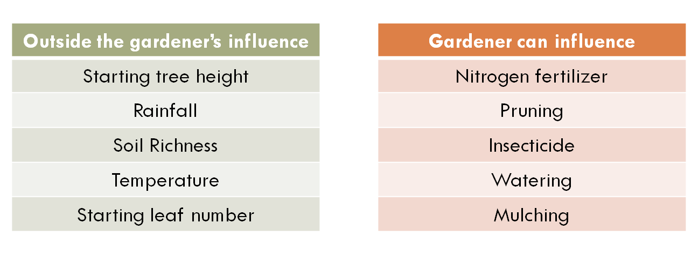
2. How does VARC choose what to control for?
(Proxy measures for causal factors)

Slide 16
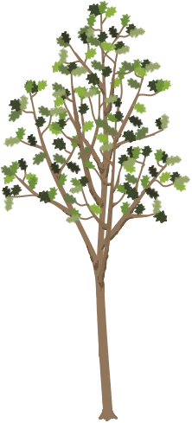
2. How does VARC choose what to control for?
Imagine we want to evaluate another pair of gardeners and we notice that there is something else different about their trees that we have not controlled for in the model.
In this example, Oak F has many more leaves than Oak E.
Is this something we could account for in our predictions?
73 in.
73 in.
Gardener E
Gardener F
Oak E
Age 5
Oak F
Age 5
Notes:
Imagine we want to evaluate another pair of gardeners and we notice that there is something else different about their trees that we have not controlled for in the model.
In this example, Oak F has many more leaves than Oak E.
Is this something we could account for in our predictions?

Slide 17
In order to be considered for inclusion in the Value-Added model, a characteristic must meet several requirements:
Check 1: Is this factor outside the gardener’s influence?
Check 2: Do we have reliable data?
Check 3: If not, can we pick up the effect by proxy?
Check 4: Does it increase the predictive power of the model?
Notes:
In order to be considered for inclusion in the Value-Added model, a characteristic must meet several requirements:
Check 1: Is this factor outside the gardener’s influence?
Check 2: Do we have reliable data?
Check 3: Can we approximate it with other data?
Check 4: Does it increase the predictive power of the model?

Slide 18
Check 1: Is this factor outside the gardener’s influence?
Outside the gardener’s influence
Starting tree height
Rainfall
Soil Richness
Temperature
Starting leaf number
Gardener can influence
Nitrogen fertilizer
Pruning
Insecticide
Watering
Mulching
Notes:
Check 1: Is this factor outside the gardener’s influence?
Here are some examples of categorized factors.
In a Value-Added model, we could potentially control for items in the green box.
Since the gardener could influence items in the red box, we would NOT want to control for them in the Value-Added model.

Slide 19
Check 2: Do we have reliable data?
Category | Measurement | Coverage
Yearly record of tree height | Height (Inches) | 100%
Rainfall | Rainfall (Inches) | 98%
Soil Richness | Plant Nutrients (PPM) | 96%
Temperature | Average Temperature (Degrees Celsius) | 100%
Starting leaf number | Individual Leaf Count | 7%
Canopy diameter | Diameter (Inches) | 97%
Notes:
Check 2: Do we have reliable data?
In 7% of cases, actual leaf number was recorded for trees. This is not enough to include this data in the Value-Added model.

Slide 20
Check 3: Can we approximate it with other data?
Category | Measurement | Coverage
Yearly record of tree height | Height (Inches) | 100%
Rainfall | Rainfall (Inches) | 98%
Soil Richness | Plant Nutrients (PPM) | 96%
Temperature | Average Temperature (Degrees Celsius) | 100%
Starting leaf number | Individual Leaf Count | 7%
Canopy diameter | Diameter (Inches) | 97%
?
Notes:
Check 3: Can we approximate it with other data?
It may be the case that canopy diameter could be used as a proxy for the real data we desire.

Slide 21
Canopy diameter as a proxy for leaf count
The data we do have available about canopy diameter might help us measure the effect of leaf number.
The canopy diameter might also be picking up other factors that may influence tree growth.
We will check its relationship to growth to determine if it is a candidate for inclusion in the model.
Gardener E
Gardener F
33 in.
55 in.
Oak E
Age 5
Oak F
Age 5
Notes:
The data we do have available about canopy diameter might help us measure the effect of leaf number.
Check 4 involves increasing the predictive power to the model.

Slide 22
If we find a relationship between starting tree diameter and growth, we would want to control for starting diameter in the Value-Added model.
The Effect of Tree Diameter on Growth
?
Growth from Year 5 to 6 (inches)
Tree Diameter (Year 5 Diameter in Inches)
Notes:
If we find a relationship between starting diameter and growth, we would want to control for starting diameter in the Value-Added model.
We might find that on its own, tree diameter does not have a clear effect on growth.

Slide 23
If we find a relationship between starting tree diameter and growth, we would want to control for starting diameter in the Value-Added model.
The Effect of Tree Diameter on Growth
Growth from Year 5 to 6 (inches)
Tree Diameter (Year 5 Diameter in Inches)
Notes:
We might find that tree diameter has a strong effect on growth.
If so, we would want to include starting tree diameter in our predictions to be fair to the gardeners.

Slide 24
What happens in the education context?
Check 1: Is this factor outside the school or teacher’s influence?
Check 2: Do we have reliable data?
Check 3: If not, can we pick up the effect by proxy?
Check 4: Does it increase the predictive power of the model?
Notes:
In order to be considered for inclusion in the Value-Added model, a characteristic must meet several requirements:
Check 1: Is this factor outside the gardener’s influence?
Check 2: Do we have reliable data?
Check 3: Can we approximate it with other data?
Check 4: Does it increase the predictive power of the model?

Slide 25
Check 1: Is this factor outside the school or teacher’s influence?
Outside the school’s influence
At home support
English language learner status
Gender
Household financial resources
Learning disability
Prior knowledge
School can influence
Curriculum
Classroom teacher
School culture
Math pull-out program at school
Structure of lessons in school
Safety at the school
Let’s use “Household financial resources” as an example
Notes:
Check 1: Is this factor outside the gardener’s influence?
Here are some examples of categorized factors.
In a Value-Added model, we could potentially control for items in the green box.
Since the school or teacher could influence items in the red box, we would NOT want to control for them in the Value-Added model.

Slide 26
Check 2: Do we have reliable data?
What we want
Household financial resources
Notes:
One example of a non-school factor we want to control for is household financial resources.
Ideally for our calculations, we would have a comprehensive list of resources available for each student.

Slide 27
Check 3: Can we approximate it with other data?
What we want
Household financial resources
What we have
Free / reduced lunch status
Related data
Using your knowledge of student learning, why might
“household financial resources” have an effect on student growth?
Check 4: “Does it increase the predictive power of the model?” will be determined by a multivariate linear regression model based on real data from your district or state (not pictured) to determine whether FRL status had an effect on student growth.
Notes:
Since that data is not available, we use what we do have as a substitute for our ideal data.
In most districts and states, we use eligibility for free and reduced lunch status.
This does not give us a complete picture of the financial resources available at a student’s household, but it is related data and is the best approximation we have available on the topic.
Using your knowledge of student learning, why might “household financial resources” have an effect on student growth?
Reasons we have heard from educators include:
Different access to technology, such as computers at home
Different likelihood to have external help available, such as paid tutoring services
Possible difference in parental availability for homework and study help due to multiple jobs
You can probably think of other reasons why household financial resources might affect student growth. Since these reasons are not something the school is responsible for, we want to remove the influence of this factor as best we can in order to fairly evaluate schools serving different student populations.
Check 4 would be based on a multivariate linear regression model to determine whether FRL status had an effect on student growth in your district or state.
If we find a district-wide or state-wide difference in growth trend based on financial resources, we can customized our predicted outcomes for students based on this characteristic.
LIVE PRESENTER NOTES:
Some possible talking points on the question:
Doug Harris’s book points (summer learning loss, etc.)
From Doug Harris Book:
“Should value-added models take into account student race,
income, and other student factors in estimating value-added?
This is one of the more controversial questions in using value-added for
accountability. In one respect, the issue boils down to whether taking
into account prior achievement is enough. Race, ethnicity, and
income are after all closely related to student attainment on test scores
(see Figure 1.1). But it turns out that these factors are less closely
related to achievement growth.
The reason for this should be intuitive: if student demographics
are associated with achievement in every grade, then the association
should largely “cancel out” when subtracting the two. Here is a
simple, concrete example to highlight this: Suppose that a student
scored 60 points in one year and 80 points in the next year and grade,
for growth of 20 points. Now, suppose that part of the reason
explaining these scores is that fact that the students’ parents do not
make sure the child does her homework each night (in all years). This
might reduce the student’s score by 5 points in each year from what it
would have been. So, the student would have scored 65 and 85
(instead of 60 and 8) if the student had done her homework. Notice
that the growth is exactly the same in both cases—20 points. So long
as the influence on student scores is constant over time, the influence
on scores should cancel out in this way.
But minority and low-income students do still learn at slower
rates. One study finds that while most of the gap by family income
exists in 1st grade, it grows by about 30 percent between 1st and 5th
grade.1 Almost all of this, in turn is due, not to what happens in
school, but to the “summer learning loss,” the period between school
years when students are not in school. This is most likely because
the same factors creating the starting gate inequalities also affect
learning growth. Because standardized tests are not administered at
the beginning of the school year, the summer learning loss is
embedded within the student growth measures. Further, the summer
learning loss is substantially outside the control of schools and
therefore problematic. An accurate measure of value-added must take
into account all of the factors outside their control.
The concern with accounting for race and income, however, is
that some see it as reducing expectations for these students. There
are legitimate differences of opinion on this point, but let me clarify
the two different meanings of “lower expectations.” On the one hand,
this could mean that accounting for race and income means that
schools can get by giving less effort to raise achievement for
disadvantaged students. Value-added measures that account for race
and income do not lower expectations in this sense. In fact, the whole
point of value-added is to create an even playing field and one that
provides incentives for schools to help all students.
Alternatively, some interpret “lower expectations” to mean that
schools serving disadvantaged students will have the same measured
performance as schools serving advantaged students while generating
less student learning. If this is what is meant by lower expectations,
then it is a legitimate point. Value-added models that adjust
predictions based on student race and income do require less learning
of disadvantaged students to reach the same level of school
performance. Again, this just reflects the fact that schools should not
be held accountable for factors outside their control and students’
home environments and other factors affecting students clearly fall
into that category.
There is some potential middle ground on this issue. If the
concern is about how much emphasis schools place on achievement of
different groups, value-added measures can be designed to place as
much or as little weight on disadvantaged students as we wish. For
example, we could design the accountability system so that 10 points
in growth for a low-income student counts twice as much as for a
high-income student. Also, when statisticians estimate value-added,
they also end up estimating the statistical relationship (correlation)
between student race and income and student achievement growth
(see Oakville example above). Districts could use the measured role of
student disadvantage as an indicator of how well the district is doing
to overcome racial and income achievement gaps.2 If socio-economic
disadvantage is associated with lower growth, then this might
motivate districts to try even harder to address the issue. That is,
rather than lowering expectations, it can be a driver of higher
expectations and even greater effort for those students.
It is also worth recalling that value-added measures can help
reduce the problem of driving out teachers of low-attainment schools.
The same goes for disadvantaged students. To the degree that
student race and income are associated with their achievement
growth, failing to account for those factors will place the teachers of
those students at a disadvantage.
In my view, it is best to account for student race and income
when predicting each school’s achievement. The reason comes back
to the Cardinal Rule: Hold people accountable for what they can
control. While this means that schools serving disadvantaged
students will receive higher performance ratings with less growth, it
does not mean that schools can get by with giving less effort to these
students. If, in addition, we give disproportionate weight to the
growth of racial minorities and low-income students, and use the
statistical relationship between student disadvantage and student
achievement growth as a motivation to address the gap, then
accounting for student disadvantage would seems to raise
expectations—and outcomes—for these students rather than lower
them. I cannot prove that, unfortunately, but there is a strong
rationale behind it.”

Slide 28
What about race/ethnicity?
Race/ethnicity causes higher or lower performance
What we want
General socio-economic status
Family structure
Family education
Social capital
Environmental stress
What we have
Race/ethnicity
Related complementary data may correlate with one another
(not a causal relationship)
Check 4 will use real data from your district or state to determine if race/ethnicity has an effect on student growth.
If there is no effect, we decide with our partners whether to leave it in.
Notes:
What about race and ethnicity?
One of the pieces of data often collected is student race and ethnicity.
Why might we include this in the model?
Rather than a causal relationship between race and student growth, it might be the case that race/ethnicity is picking up the effect of factors like general socio-economic status, family structure, family education, social capital, and environmental stress.
This will not always be the case for every student, but it may be true across entire districts or states.
During check 4, VARC uses real data from your district or state to determine if race/ethnicity has an effect on student growth.
If there is no effect, we decide with our partners whether to leave it in.

Slide 29
What about race/ethnicity?
If there is a detectable difference in growth rates
We attribute this to a district or state challenge to be addressed
Not as something an individual teacher or school should be expected to overcome on their own
Notes:
If there is a detectable difference in growth rates of different groups of students, we attribute this to a district or state challenge to be addressed, not something an individual teacher or school should be expected to overcome on their own. If a particular school, grade-level team, or teacher is making above-average results with any group of students, this will be reflected in an above-average Value-Added estimate.
By using all the data we have available, we try to get the most complete picture of the real situations of students to make our predictions as accurate as possible. The more complete job VARC can do at controlling for external factors, the more accurate we can be about evaluating the effect of districts, schools, grades, classrooms, programs, and interventions.

Slide 30
Checking for Understanding
What would you tell a 5th grade teacher who said they wanted to include the following in the Value-Added model for their results?:
5th grade reading curriculum
Their students’ attendance during 5th grade
Their students’ prior attendance during 4th grade
Student motivation
Check 1: Is this factor outside the school or teacher’s influence?
Check 2: Do we have reliable data?
Check 3: If not, can we pick up the effect by proxy?
Check 4: Does it increase the predictive power of the model?
Notes:
VARC suggested answers:
A. 5th grade reading curriculum fails at “check 1”. A school or teachers could have an influence on the curriculum that’s chosen and the implementation of the curriculum. This would be like fertilizer in the gardener analogy. It’s one of the strategies employed to try to get a desired result. We don’t want to control for this in the model, since the effect of this and other strategies is what we’re trying to measure and isolate with our outcome.
B. Can a really engaging teacher get his or her students to come to school more often? Maybe. This could potentially fail at “check 1” since the teacher may be able to influence this outcome.
C. Can a 5th grade teacher get students to come to school more often one year in the past? No. This is our chance to try to pick up the effect of attendance. It passes “check 1”, so let’s go to “check 2”. Do we have reliable data?
The answer to this part varies by district or state. If we do have reliable attendance data, we’d continue to “check 4” to determine if it increases the predictive power of the model.
(For more information on the difference between B and C, please see the explanation below… after D)
D. Does a teacher have control over student motivation? It probably depends on how we define “motivation”. If we decide whether it passes “check 1”, we move on to “check 2” and “check 3” to see if we have data on it or can pick it up by proxy. Most likely the answers to both of these is “no”.
It’s important to note here that this is an example of something we would like to control for, but we do not have the data to do so.
Value-Added is not a perfect measure, but it is the best we’re able to do with the existing data. VARC’s model is continually improving as we make statistical innovations and new student data becomes available. Our hope is that over time, our models become better and better at fairly measuring educator effectiveness.
Consider the next section for why it’s reasonable to consider Value-Added measures as useful even when we don’t have the whole picture (including student motivation and other unmeasured characteristics)
More information on attendance (taken from VARC’s answer to “How does the model account for student attendance” in the LAUSD FAQ)
In LAUSD, Value-Added is called “AGT”
How does the model account for student attendance?
Attendance is not included in the AGT model. LAUSD's data systems do not currently have enough information to produce a reliable AGT dosage model based on attendance data. LAUSD is working to improve the data system so future analysis years will take this data into account.
When reliable data is available, the AGT model will account for prior attendance rather than attendance for the year being measured by AGT.
Why would we account for prior attendance rather than current attendance? As with other variables controlled for in the AGT model, we want to remove the effect of factors beyond the school’s or teacher’s control. When a student is assigned to a teacher, there may be strategies the teacher can use to get a previously low-attending student to come to class more often (strong parent interactions, engaging classroom activities, encouraging classroom community building, etc.) On the other hand, this particular teacher does not have any control over the attendance history of that student from previous years (before they entered this teacher’s classroom).
Let’s assume that across the district, our analysis found that students with lower attendance grew less than students with higher attendance.
In the following example, we will consider that there are two 7th grade math teachers. These two teachers have been assigned two groups of students who have exactly the same characteristics, including a low average attendance rate (75%) from last year.
During the past year, teacher A used strategies in her classroom that resulted in her students having a much higher attendance rate than these students had last year. The average attendance rate for her students was 90% instead of 75%.
In teacher B’s classroom, there were no strategies used to increase student attendance, and her students actually had a much lower attendance rate than they had last year. The average attendance rater for her students was 60% instead of 75%.
With the situation above, let’s explore the results we would get with an AGT model that controlled for current attendance vs. prior attendance.
In an AGT model, student growth for a given teacher’s classroom is compared to the predicted growth of those students. This prediction is based on the average growth of similar students (accounting for prior test performance and student characteristics) across LAUSD during the same time period.
If AGT controlled for current attendance in the above scenario:
Teacher A’s prediction for growth of her students would be based on students across the district who also had 90% attendance rate. Since we assumed the probable outcome that students with higher attendance rates learn more during the school year, teacher A’s predicted growth would be higher since her students came to school more often than they did in the past.
In the case of teacher B, her prediction for the growth of her students would be based on students across the district that also had 60% attendance rate. Teacher B’s predicted growth would be lower since her students came to the school less often than they did in the past.
In this case, teacher A (who managed to get incredible attendance for her students) is held to a higher prediction than teacher B (who ended up with much lower attendance for her students). This would set up an incentive structure where teachers would be more likely to get high AGT if their students had lower attendance. We want higher attendance for our students, so AGT should not be set up this way.
On the other hand, if AGT controlled for prior attendance in the above scenario:
Teacher A and teacher B would have exactly the same predicted growth for their students. Their predicted performance would be based on the growth of similar students across the district that had the same 75% attendance rate for the previous year.
Teacher A, with her higher attendance rate, would be more likely to have a higher AGT result with that increased instruction time in the classroom. Teacher B, with her low attendance rate, would be more likely to have a lower AGT result with less instructional time in the classroom.
This matches our intended incentive structure, where teacher who use strategies to get historically low attending students to come to school get recognition for this results in their student growth.

Slide 31
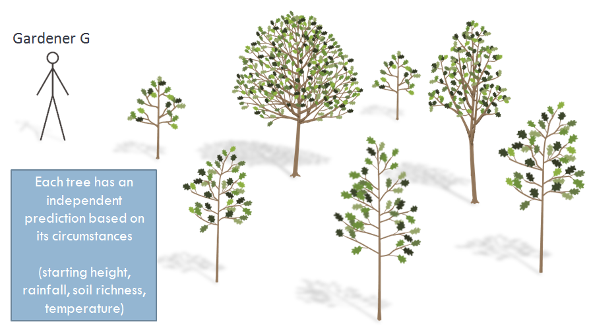
3. What if a gardener just gets lucky or unlucky?
(Groups of students and confidence intervals)

Slide 32
3. What if a gardener just gets lucky or unlucky?
Gardener G
Oak A predicted growth:
10 inches
Oak A
Age 3
(1 year ago)
Predicted
Oak A
Notes:
What if a gardener just gets lucky or unlucky?
Based on all available data for Oak A, we predict that by the end of the year, Oak A will grow 10 inches.

Slide 33
Gardener G
Oak A actual growth:
2 inches
For an individual tree, our predictions do not account for random events.
Oak A
Age 3
(1 year ago)
Actual
Oak A
Notes:
But there are limits to what our predictions can tell us.
For an individual tree, our predictions do not account for random events.

Slide 34
Gardeners are assigned to many trees
Gardener G
Each tree has an independent prediction based on its circumstances
(starting height, rainfall, soil richness, temperature)
Notes:
In the oak tree analogy, we have been considering a single tree for each gardener.
To be a more accurate portrayal of how Value-Added works, gardeners would be assigned to many trees.
Each of the gardener’s trees has an independent set of circumstances (prior height, rainfall, etc.), so the prediction for each tree will be customized for its own situation.

Slide 35
How confident would you be about the effect of these gardeners?
Gardener G
Total trees assigned
5
Trees that missed predicted growth
3
Trees that beat predicted growth
2
Due to unlucky year
2
Due to gardener
1
Due to gardener
2
Due to lucky year
0
Gardener H
Total trees assigned
50
Trees that missed predicted growth
30
Trees that beat predicted growth
20
Due to unlucky year
7
Due to gardener
23
Due to gardener
15
Due to lucky year
5
Notes:
A Value-Added estimate represents the average effect of the gardener on this group of assigned trees.
Since individual trees could have a lucky or unlucky year, the more trees a gardener is assigned to, the more sure we can be about the effect of the gardener.

Slide 36
Reporting Value-Added
In the latest generation of Value-Added reports, estimates are color coded based on statistical significance. This represents how confident we are about the effect of schools and teachers on student academic growth.
Green and Blue results are areas of relative strength.
Student growth is above average.
Gray results are on track. In these areas, there was not enough data available to differentiate this result from average.
Yellow and Red results are areas of relative weakness.
Student growth is below average.

Slide 37
3
Numbers lower than 3.0 represent growth that did not meet prediction.
Students are still learning, but at a rate slower than predicted.
3.0 represents meeting predicted growth for your students.
Since predictions are based on the actual performance of students in your district or state, 3.0 also represents the district or state average growth for students similar to yours.
Numbers higher than 3.0 represent growth that beat prediction.
Students are learning at a rate faster than predicted.
Value-Added is displayed on a
1-5 scale for reporting purposes.
About 95% of estimates will fall between 1 and 5 on the scale.
Grade 4
30

Slide 38
3
READING
Grade 4
30
3.8
95% Confidence Interval
Value-Added estimates are provided with a confidence interval.
Based on the data available for these thirty 4th Grade Reading students, we are 95% confident that the true Value-Added lies between the endpoints of this confidence interval (between 3.2 and 4.4 in this example), with the most likely estimate being 3.8.

Slide 39
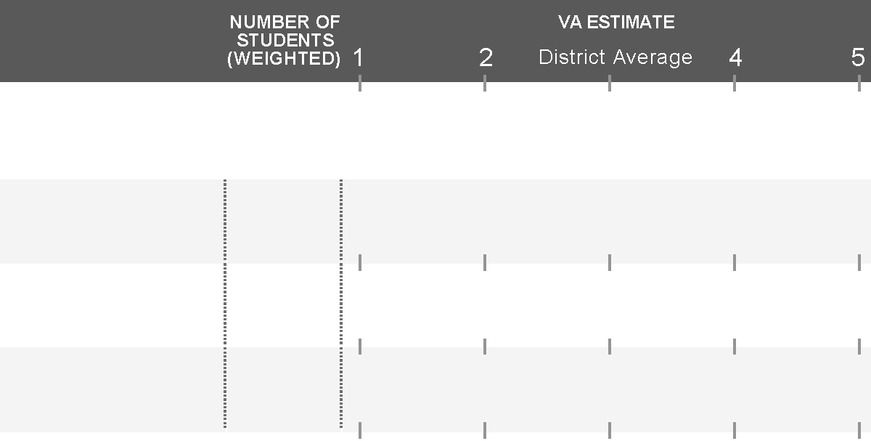
Confidence Intervals
Color coding is based on the location of the confidence interval.
The more student data available for analysis, the more confident we can be that growth trends were caused by the teacher or school (rather than random events).
3
READING
Grade 3
13
4.5
Grade 4
36
4.5
Grade 5
84
4.5
3
MATH
Grade 3
13
1.5
Grade 4
36
1.5
Grade 5
84
1.5

Slide 40
Checking for Understanding
A teacher comes to you with their Value-Added report wondering why it’s not a green or blue result.
She wants to know why there’s a confidence interval at all when VARC had data from each and every one of her students. (Don’t we know exactly how much they grew?)
3
READING
Grade 7
11
4.2
Notes:
VARC suggested answers:
The estimate has a wide confidence interval due to only 11 students in this estimate. These students grew at a rate above average for their observationally similar peers (as signified by the “4.2” point estimate), but there were too few students to be able to infer that this outcome was due to the effect of the educators involved (rather than random events or statistical noise). The long confidence interval crosses “3”, so we color code our estimate gray.
We know the scores of all these students, but Value-Added is not simply a report of how many points students grew on the test. We’re combining data from multiple sources (student test data measured with error since no test is perfect, and demographic data) from a limited number of students to try to find the true effectiveness of this educator. Imagine a scenario where there was only a single student in a classroom. Is it fair to judge the teacher’s true teaching ability based on the outcome of this single student? If we were able to observe the impact of a teacher on dozens or hundreds of students over the years, we would be more confident of the teacher’s impact on those students. With Value-Added we’re inferring this true ability by analyzing the outcomes of a relatively small number of students. The more students a teacher teaches over a period of time, the stronger our conclusions can be about the true effectiveness of the teacher. We represent how confident we are with the statistical confidence interval around our best estimate.

